Slide 1
Building Machines that learnt and think like people
10/10/19

Slide 2
Introduction
Artificial intelligence (AI) has been a story of booms and busts, yet by any traditional measure of success, the last few years have been marked by exceptional progress.
Much of this progress has come from recent advances in “deep learning,” characterized by learning large neural-network-style models with multiple layers of representation.
These models have achieved remarkable gains in many domains spanning object recognition, speech recognition.

Slide 3
Some Successful stories
In object recognition, Krizhevsky, Sutskever, and Hinton (2012) trained a deep convolutional neural network that nearly halved the error rate of the previous state-of-the-art on the most challenging benchmark to date.
In automatic speech recognition, Hidden Markov Models (HMMs) have been the leading approach since the late 1980s , yet this framework has been chipped away piece by piece and replaced with deep learning components. Now, the leading approaches to speech recognition are fully neural network systems.
V. Mnih et al. (2015) combined ideas from deep learning and reinforcement learning to make a “deep reinforcement learning” algorithm that learns to play large classes of simple video games from just frames of pixels and the game score, achieving human or superhuman level performance on many of these games.

Slide 4
Cognitive and neural inspiration in artificial intelligence
The questions of whether and how AI should relate to human cognitive psychology are older than the terms ‘artificial intelligence’ and ‘cognitive psychology.’
Alan Turing suspected that it is easier to build and educate a child-machine than try to fully capture adult human cognition (Turing, 1950).
Turing pictured the child’s mind as a notebook with “rather little mechanism and lots of blank sheets,” and the mind of a child-machine as filling in the notebook by responding to rewards and punishments, similar to reinforcement learning.
This view on representation and learning echoes behaviorism, a dominant psychological tradition in Turing’s time. It also echoes the strong empiricism of modern connectionist models, the idea that we can learn almost everything we know from the statistical patterns of sensory inputs.

Slide 5
Challenges for building more human-like machines
Lets present two challenge problems for machine learning and AI:
learning simple visual concepts and
learning to play the Atari game Frostbite.

Slide 6
The Character challenge
The first challenge concerns handwritten character recognition, a classic problem for comparing different types of machine learning algorithms.
More practically, handwritten character recognition is a real problem that children and adults must learn to solve, with practical applications ranging from reading envelope addresses or checks in an ATM machine.
Handwritten character recognition is also simpler than more general forms of object recognition – the object of interest is two-dimensional, separated from the background, and usually unoccluded.

Slide 7
The Character challenge
The standard benchmark is the MNIST data set for digit recognition, which involves classifying images of digits into the categories 0-9
The training set provides 6,000 images per class for a total of 60,000 training images.
With a large amount of training data available, many algorithms achieve respectable performance,
K-nearest neighbors - 5% test error
support vector machines - 1% test error,
convolutional neural networks - below 1% test error
The best results achieved using deep convolutional nets are very close to human-level performance at an error rate of 0.2%

Slide 8
Additional abilities
People learn from fewer examples and they learn richer representations.
People can learn to recognize a new handwritten character from a single example allowing them to discriminate between novel instances drawn by other people and similar looking non-instances
Moreover, people learn more than how to do pattern recognition: they learn a concept that is, a model of the class that allows their acquired knowledge to be flexibly applied in new ways.
In addition to recognizing new examples, people can also generate new examples , parse a character into its most important parts and relations and generate new characters given a small set of related characters.
People learn a lot more from a lot less, and capturing these human-level learning abilities in machines is the Characters Challenge.

Slide 9
Additional abilities
People learn from fewer examples and they learn richer representations.
People can learn to recognize a new handwritten character from a single example allowing them to discriminate between novel instances drawn by other people and similar looking non-instances
Moreover, people learn more than how to do pattern recognition: they learn a concept that is, a model of the class that allows their acquired knowledge to be flexibly applied in new ways.
In addition to recognizing new examples, people can also generate new examples , parse a character into its most important parts and relations and generate new characters given a small set of related characters.
People learn a lot more from a lot less, and capturing these human-level learning abilities in machines is the Characters Challenge.

Slide 10
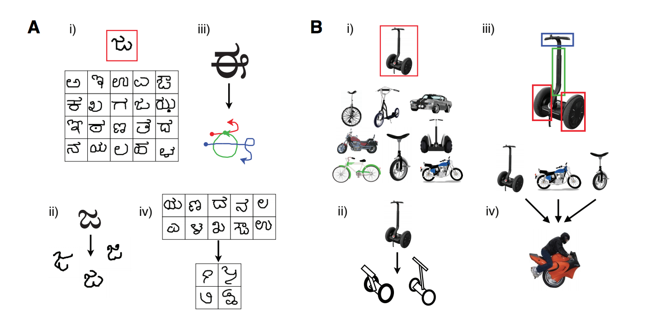
The characters challenge:
(A) human-level learning of a novel handwritten characters
(B) with the same abilities also illustrated for a novel two-wheeled vehicle.
A single example of anew visual concept (redbox) can be enough information to support the
(i) classification of new examples
(ii) generation of new examples
(iii) parsing an object into parts and relations, and
(iv) generation of new concepts from related concepts

Slide 11
The Frostbite Challenge
The second challenge concerns the Atari game Frostbite , which was one of the control problems tackled by the DQN.
The DQN was a significant advance in reinforcement learning, showing that a single algorithm can learn to play a wide variety of complex tasks.
The network was trained to play 49 classic Atari games, proposed as a test domain for reinforcement learning, impressively achieving human-level performance or above on 29 of the games.

Slide 12
The Frostbite Challenge
In Frostbite, players control an agent (Frostbite Bailey) tasked with constructing an igloo within a time limit. The igloo is built piece-by-piece as the agent jumps on ice floes in water .
The challenge is that the ice floes are in constant motion (moving either left or right), and ice floes only contribute to the construction of the igloo if they are visited in an active state (white rather than blue).
The agent may also earn extra points by gathering fish while avoiding a number of fatal hazards (falling in the water, snow geese, polar bears, etc.).
Success in this game requires a temporally extended plan to ensure the agent can accomplish a sub-goal (such as reaching an ice floe) and then safely proceed to the next sub-goal.
Ultimately, once all of the pieces of the igloo are in place, the agent must proceed to the igloo and thus complete the level before time expires .

Slide 13
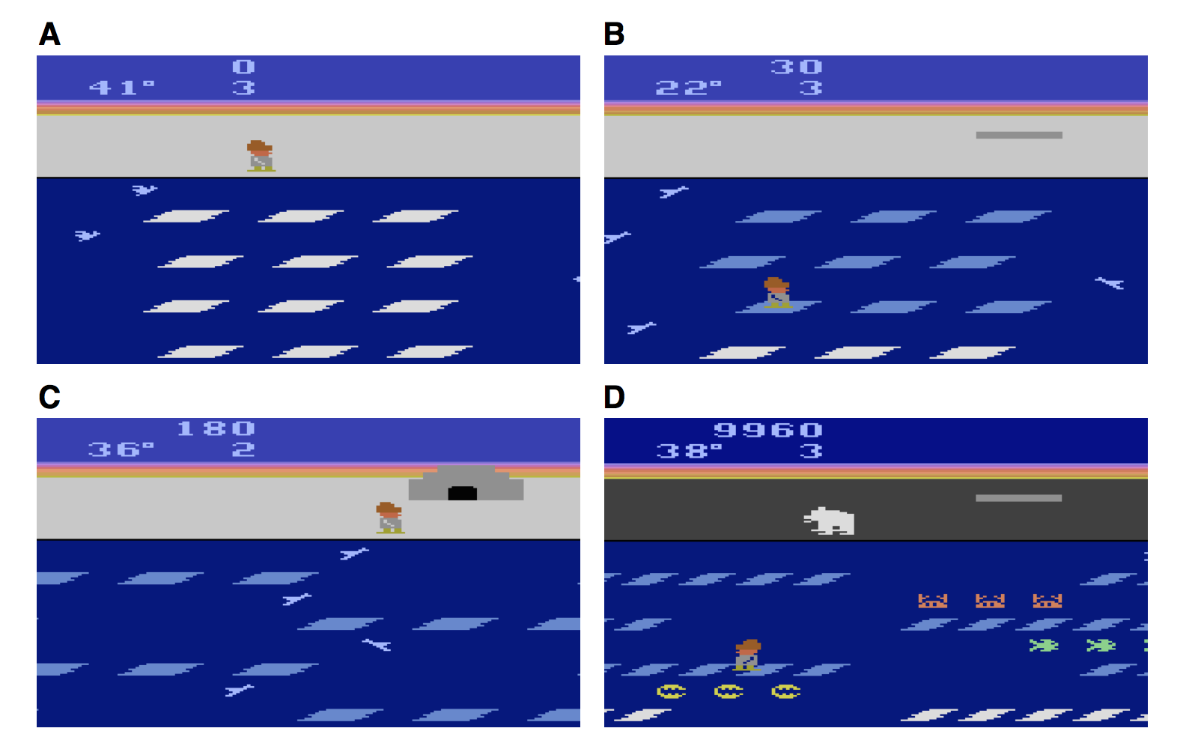
Screenshots of Frostbite, a 1983 video game designed for the Atari game console.
The start of a level in Frostbite. The agent must construct an igloo by hopping between ice floes and avoiding obstacles such as birds. The floes are in constant motion (either left or right), making multi-step planning essential to success.
The agent receives pieces of the igloo (top right) by jumping on the active ice floes (white), which then deactivates them (blue).
At the end of a level, the agent must safely reach the completed igloo.
Later levels include additional rewards(fish) and deadly obstacles (crabs, clams, and bears).

Slide 14
Outcomes
With the full 924 hours of unique experience and additional replay, the DQN achieved less than 10% of human-level performance during a controlled test session.
More recent variants of the DQN have demonstrated superior performance reaching 83% of the professional gamer’s score by incorporating smarter experience replay and 96% by using smarter replay and more efficient parameter sharing
But they requires a lot of experience to reach this level: the learning curve provided shows performance is around 46% after 231 hours, 19% after 116 hours, and below 3.5% after just 2 hours (which is close to random play, approximately 1.5%).
The differences between the human and machine learning curves suggest that they may be learning different kinds of knowledge, using different learning mechanisms, or both.

Slide 15
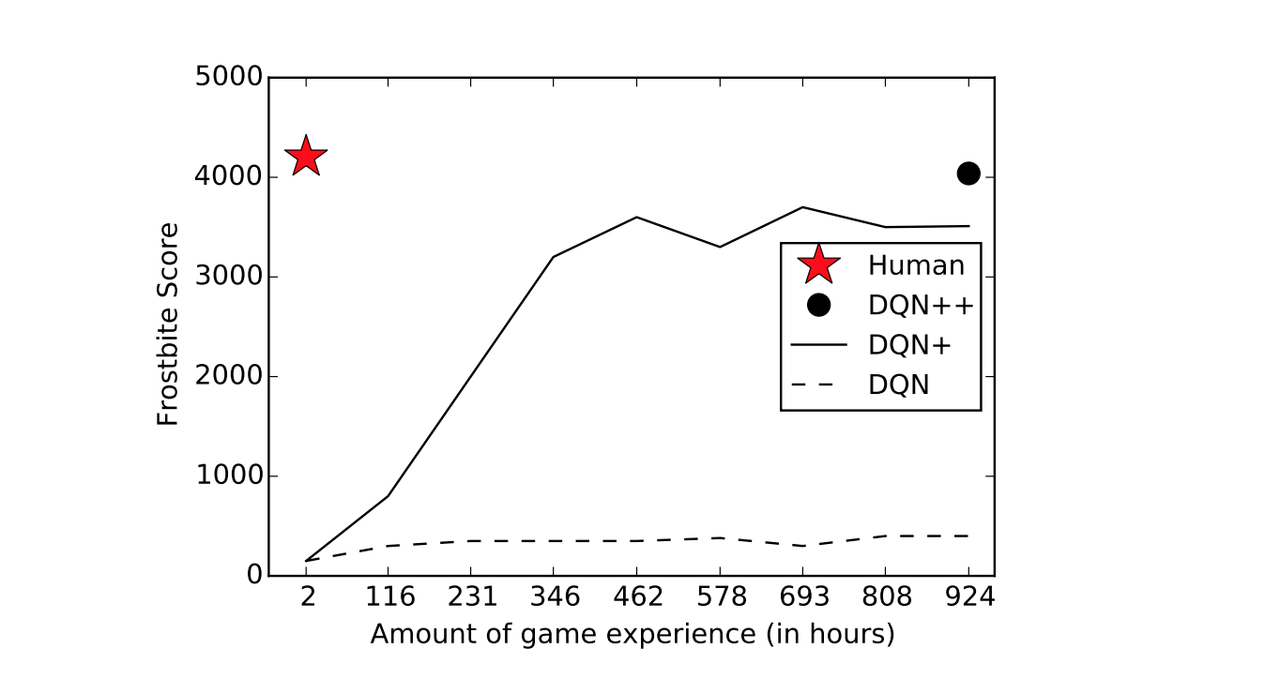
Comparing learning speed for people versus Deep Q-Networks (DQNs).
Test performance on the Atari 2600 game “Frostbite” is plotted as a function of game experience (in hours at a frame rate of 60 fps), which does not include additional experience replay.
Learning curves (if available) and scores are shown from different networks: DQN , DQN+ , and DQN++ .
Random play achieves a score of 66.4.

Slide 16
New goals
The learned DQN network is also rather inflexible to changes in its inputs and goals: changing the color or appearance of objects or changing the goals of the network would have devastating consequences on performance if the network is not retrained.
For example, imagine you are tasked with playing Frostbite with any one of these new goals:

Slide 17
New tasks and goals
Get the lowest possible score.
Get closest to 100, or 300, or 1000, or 3000, or any level, without going over.
Beat your friend, who’s playing next to you, but just barely, not by too much, so as not to embarrass them.
Go as long as you can without dying.
Die as quickly as you can.
Pass each level at the last possible minute, right before the temperature timer hits zero and you die (i.e., come as close as you can to dying from frostbite without actually dying).
Get to the furthest unexplored level without regard for your score.
See if you can discover secret Easter eggs possible.

Slide 18
New tasks and goals
Get as many fish as you can.
Touch all the individual ice floes on screen once and only once.
Teach your friend how to play as efficiently as possible.
People require little or no retraining or reconfiguration, adding new tasks and goals to their repertoire with relative ease while neural networks can learn multiple mappings or tasks with the same set of stimuli adapting their outputs depending on a specified goal, these models require substantial training or reconfiguration to add new tasks.

Slide 19
Core ingredients of human intelligence

Slide 20
People never start completely from scratch, or even close to “from scratch,” and that is the secret to their success.
The challenge of building models of human learning and thinking then becomes:
How do we bring to bear rich prior knowledge to learn new tasks and solve new problems so quickly?
What form does that prior knowledge take, and how is it constructed, from some combination of inbuilt capacities and previous experience?

Slide 21
Reference
StyleGAN
https://mc.ai/explained-a-style-based-generator-architecture-for-gans-generating-and-tuning-realistic/

Slide 22
Thank You

